Slide 1


Project Progress Update: August 2022

Slide 2

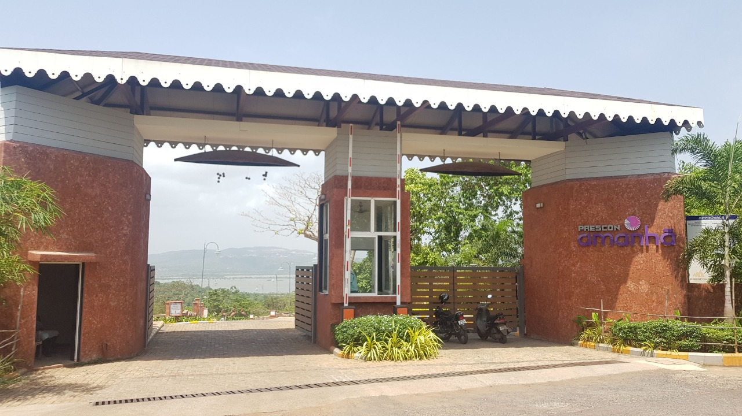
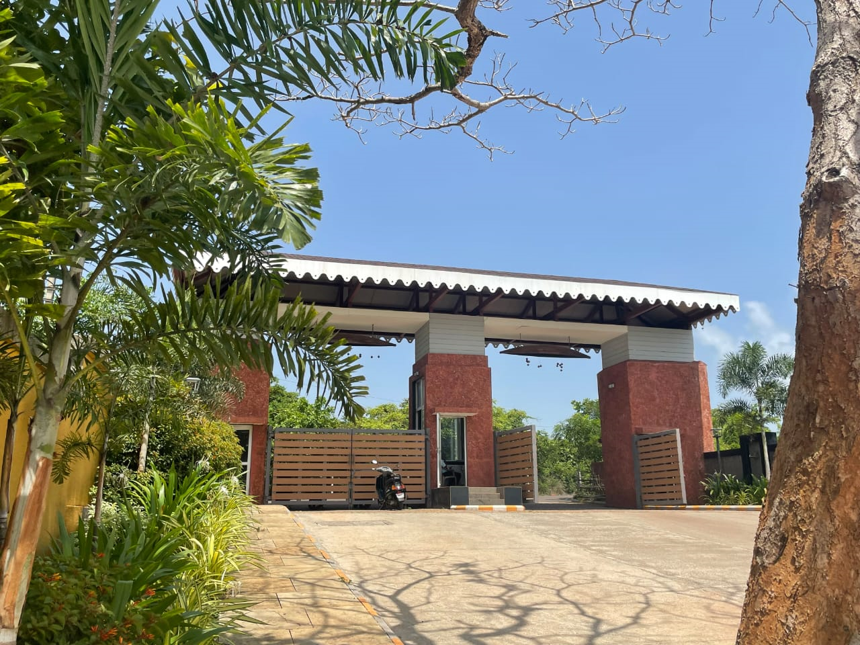
Entrance to project – IKIGAI Goa is within Prescon Amanhā, which boasts of world-class infrastructure and lush views

Slide 3
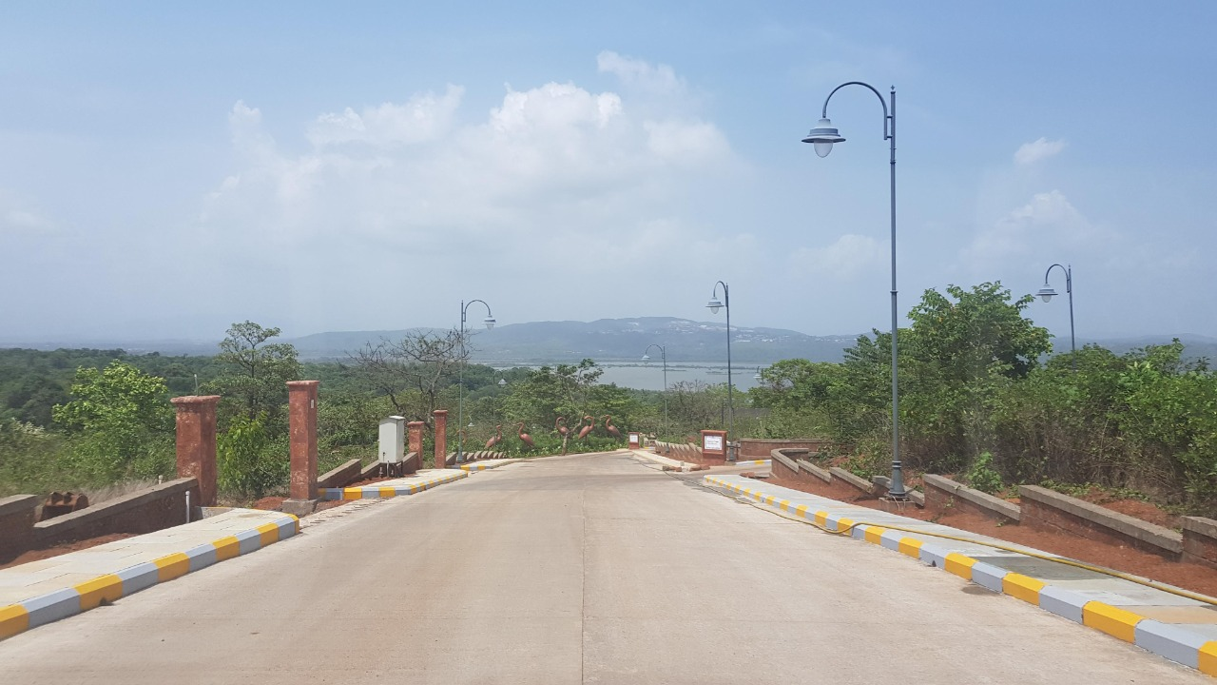
Road access to IKIGAI Goa

Slide 4
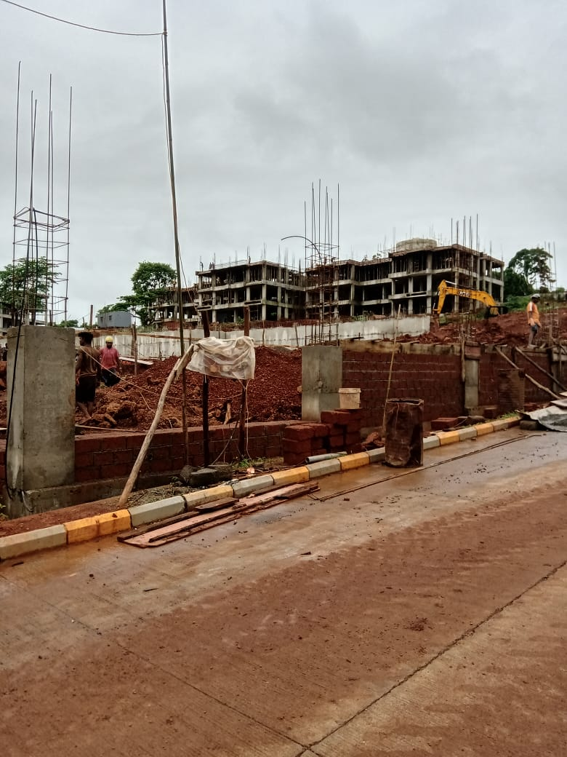
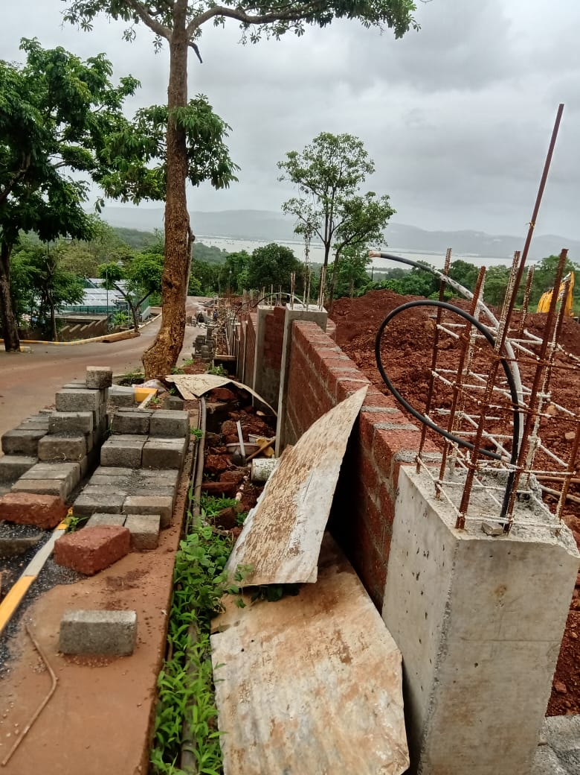
Boundary Wall - Construction in progress

Slide 5

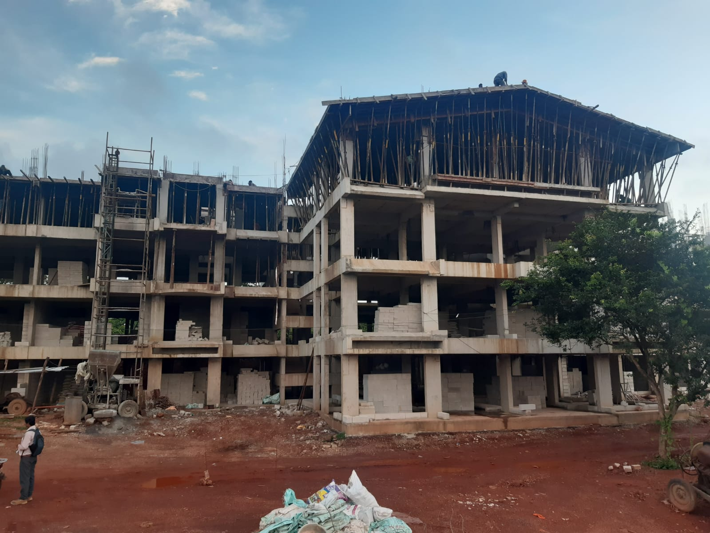
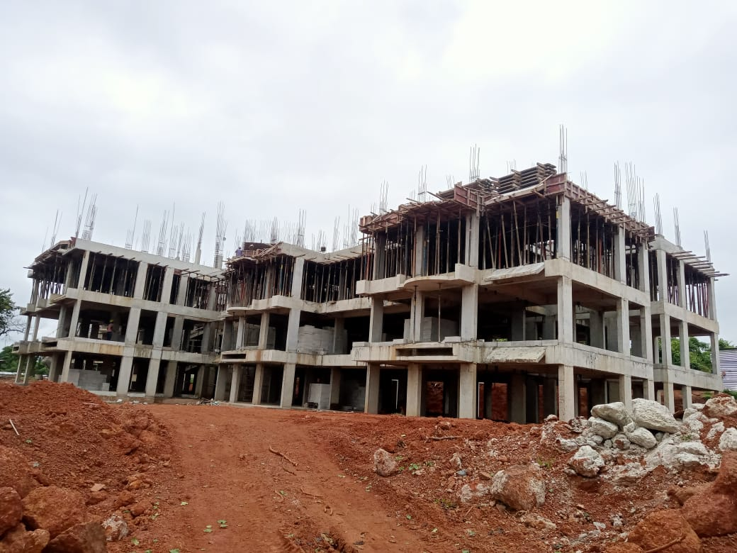
Construction in progress – A3 Building. RCC Structure upto roof slab nearing completion. Work is in full-swing.

Slide 6
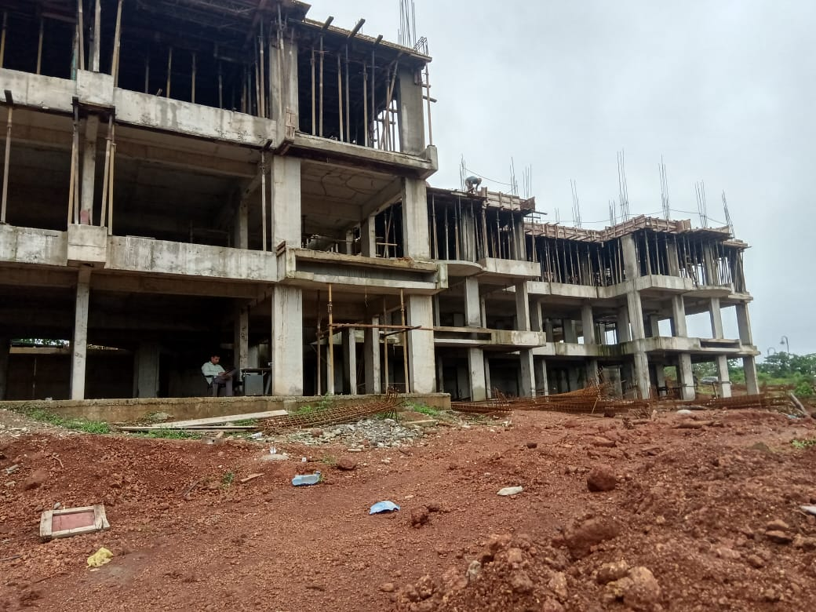
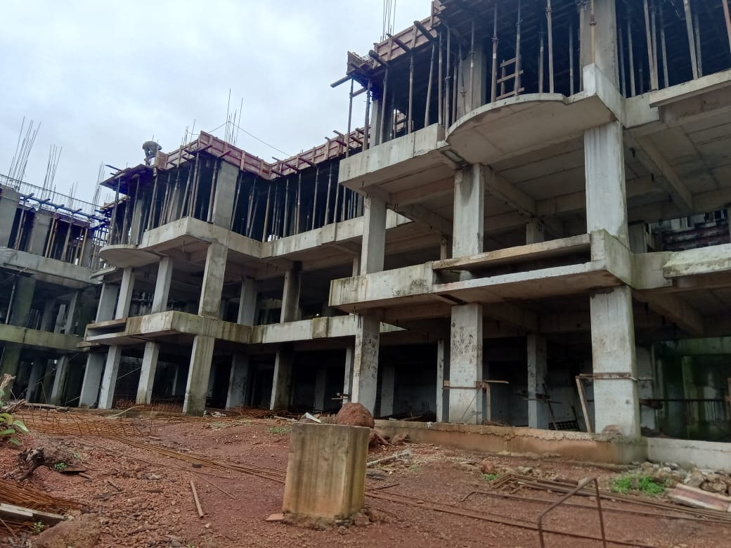
Construction in progress – A4 Building. RCC Structure completed upto 2nd Floor.

Slide 7
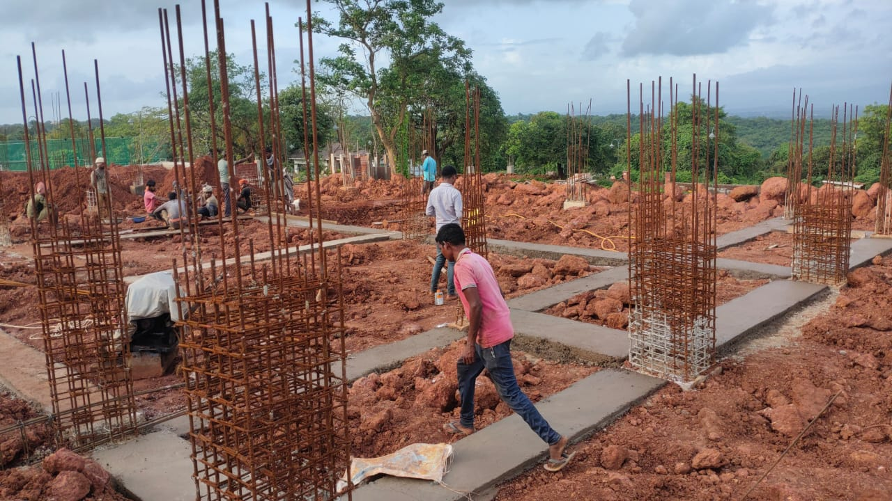
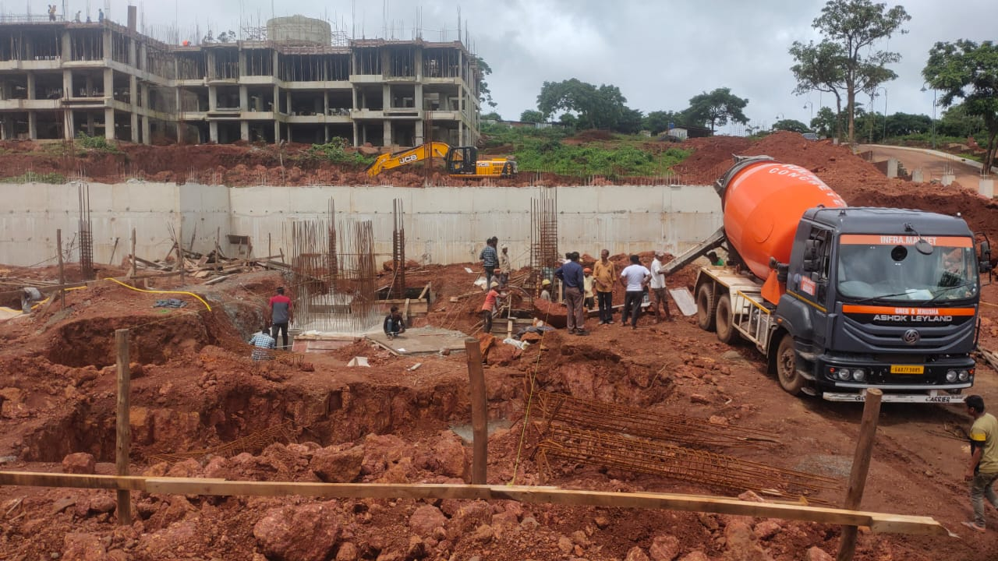
Construction in progress – Club Building retaining completed and Lower Ground Level footings underway.

Slide 8
Thank you
Address: Ikigai Goa Senior living at Prescon Amanha, Survey No. 8/1-D1, Azossim, Tiswadi, North Goa, 403104
This project is registered under GoaRera Project Registration as Bldg A3, Bldg A4 & Club with Reg. No. PRGO02221540

