Slide 1


Project Progress Update: September 2022

Slide 2

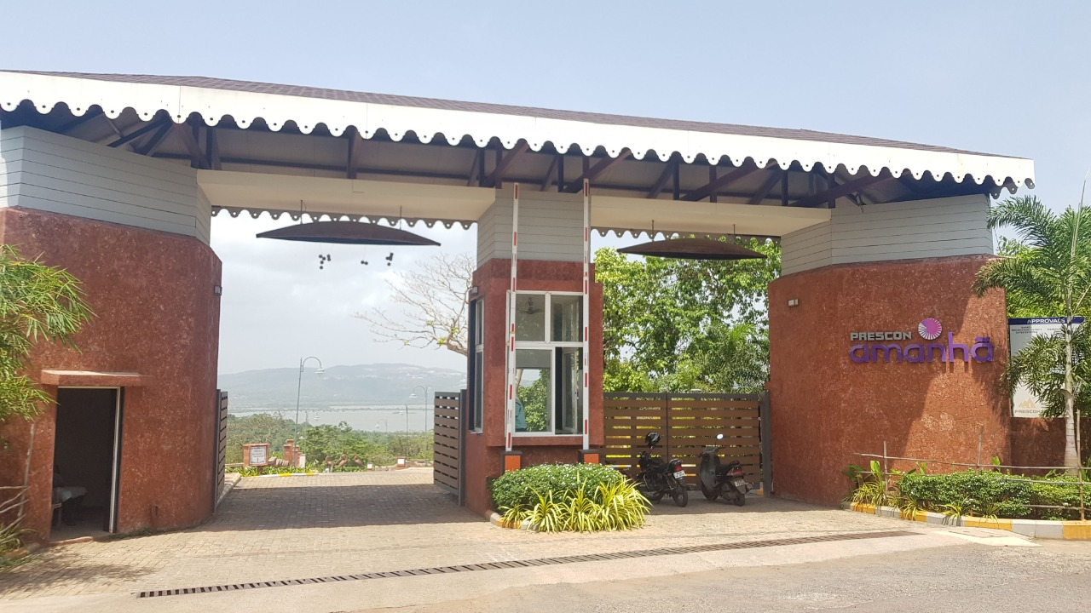
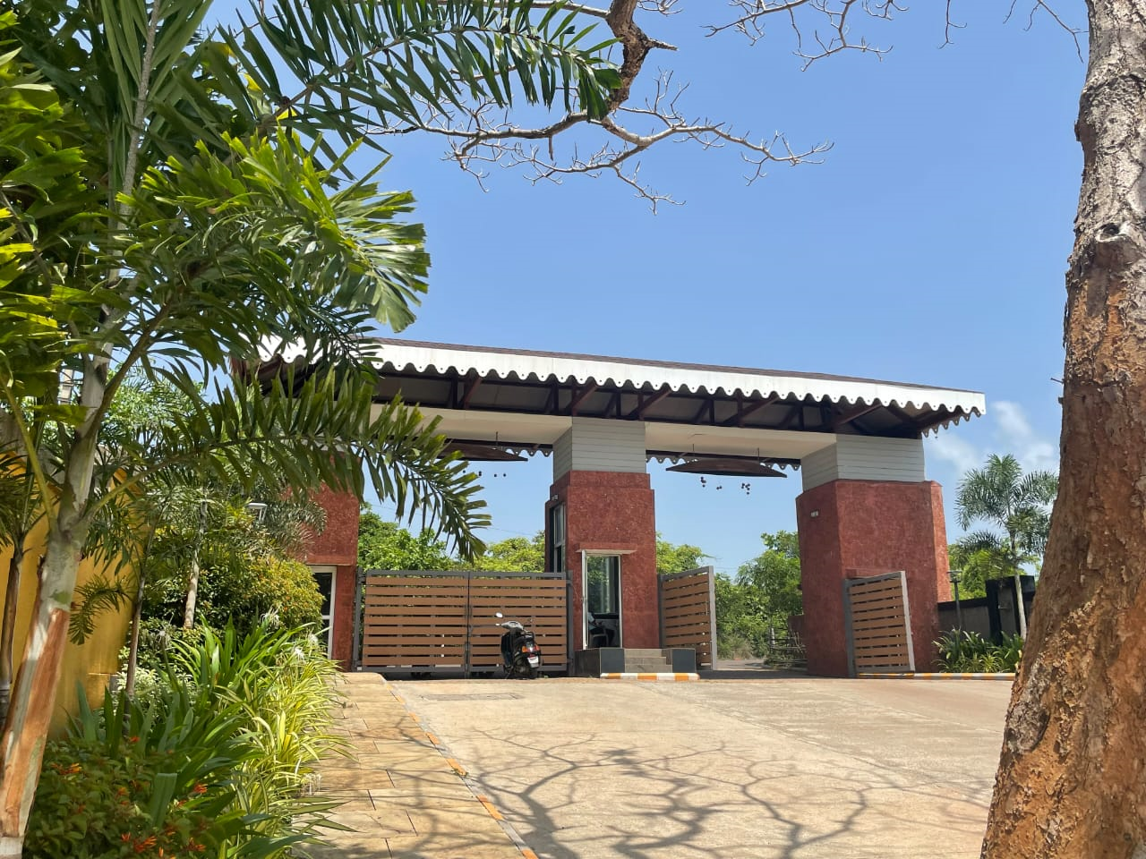
Entrance to project – IKIGAI Goa is within Prescon Amanhā, which boasts of world-class infrastructure and lush views

Slide 3
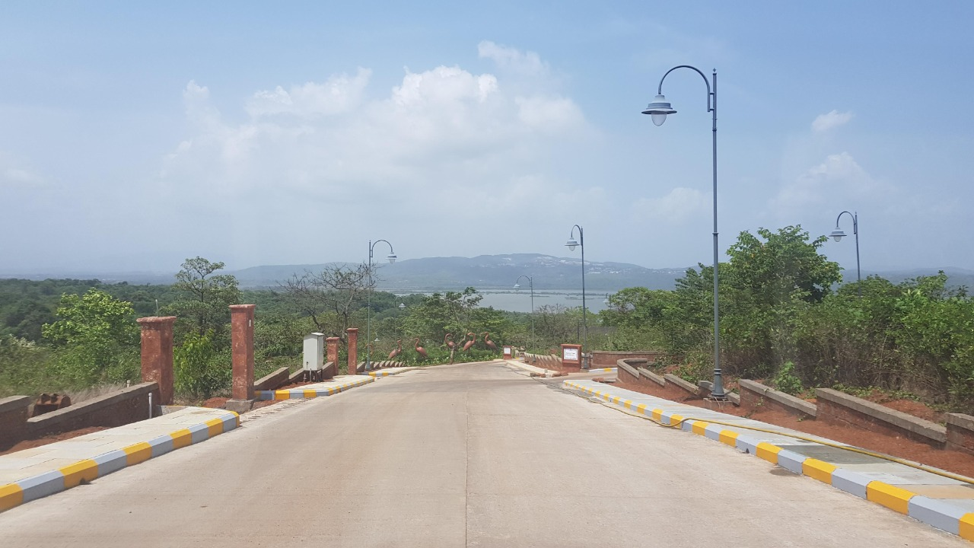
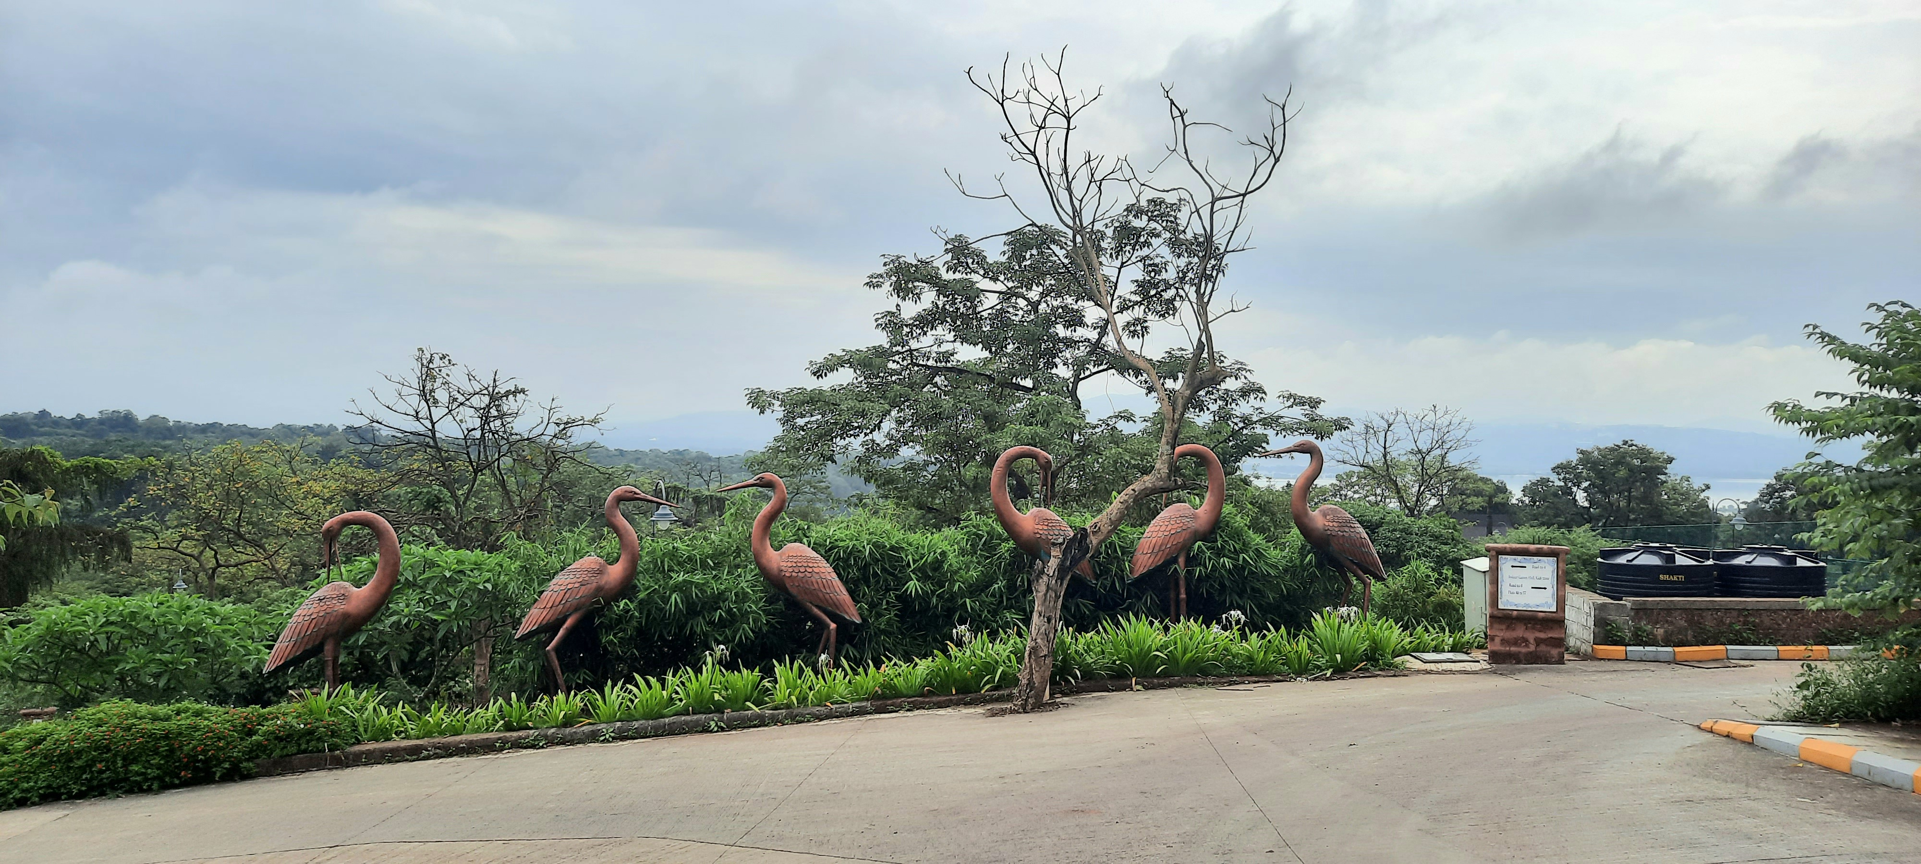
Road access to IKIGAI Goa

Slide 4
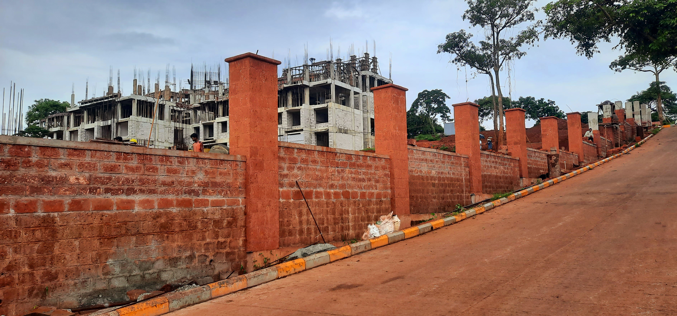
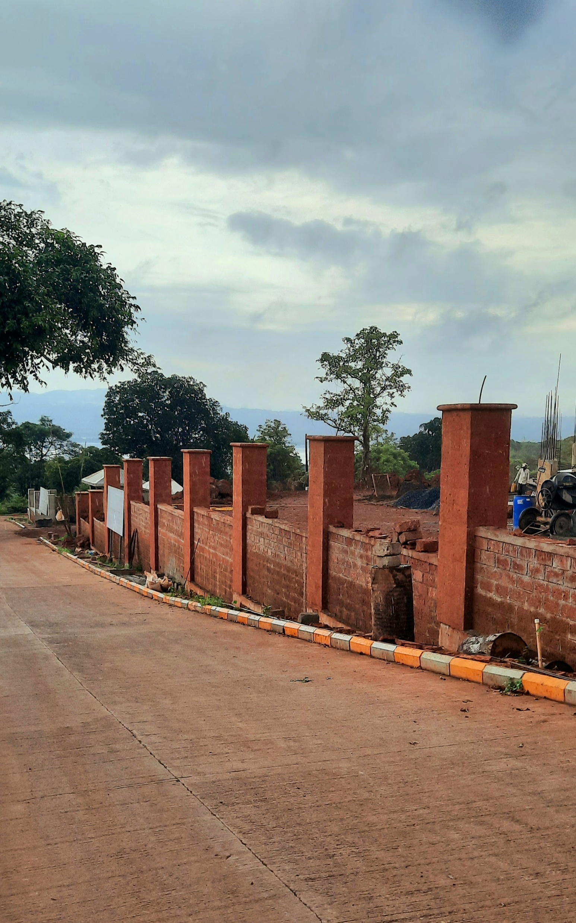
Boundary Wall – Construction nearing completion.

Slide 5
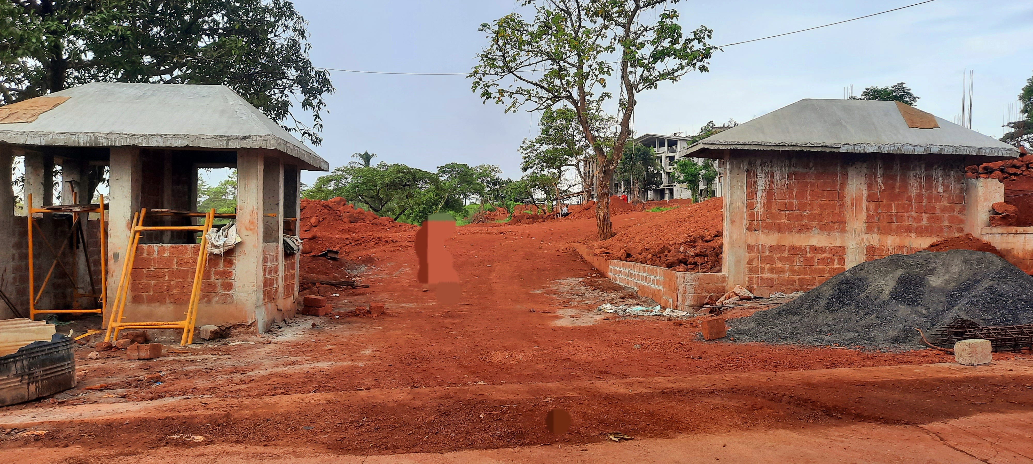
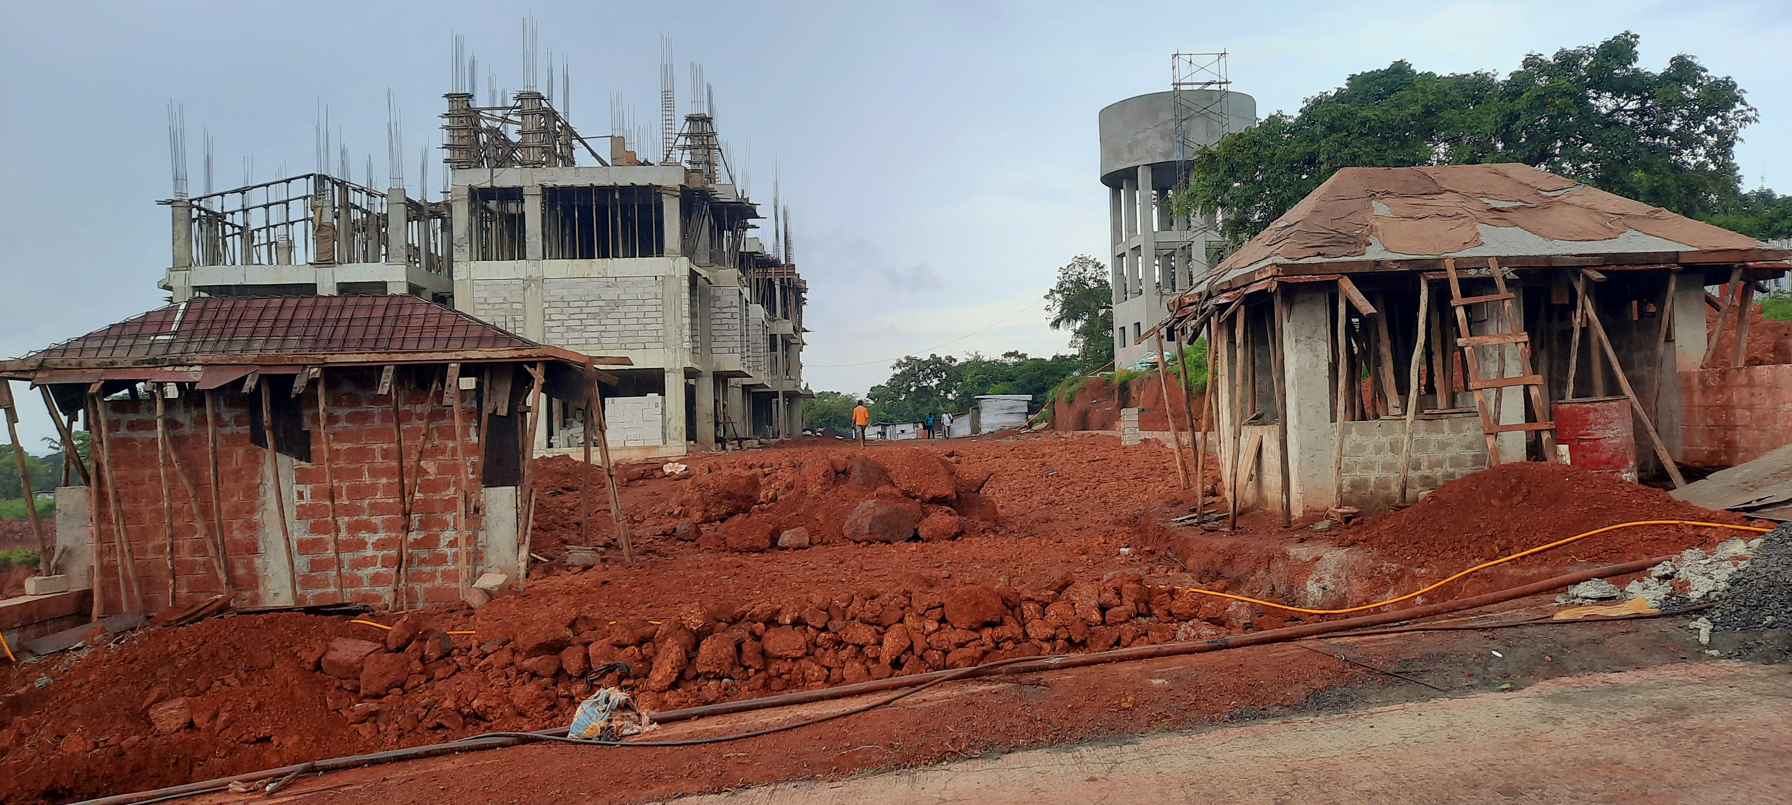
Entrance
Exit
Entrance and Exit at IKIGAI Goa

Slide 6

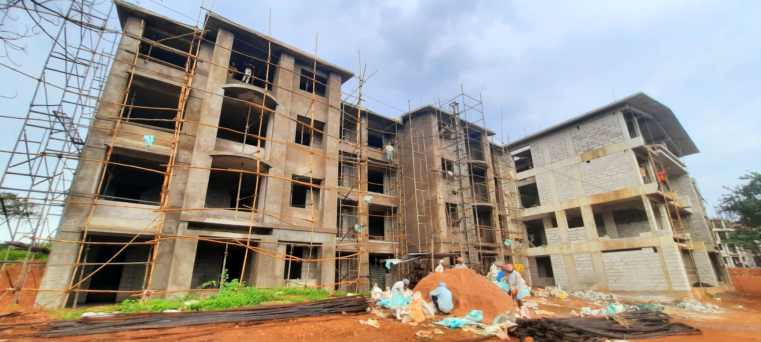
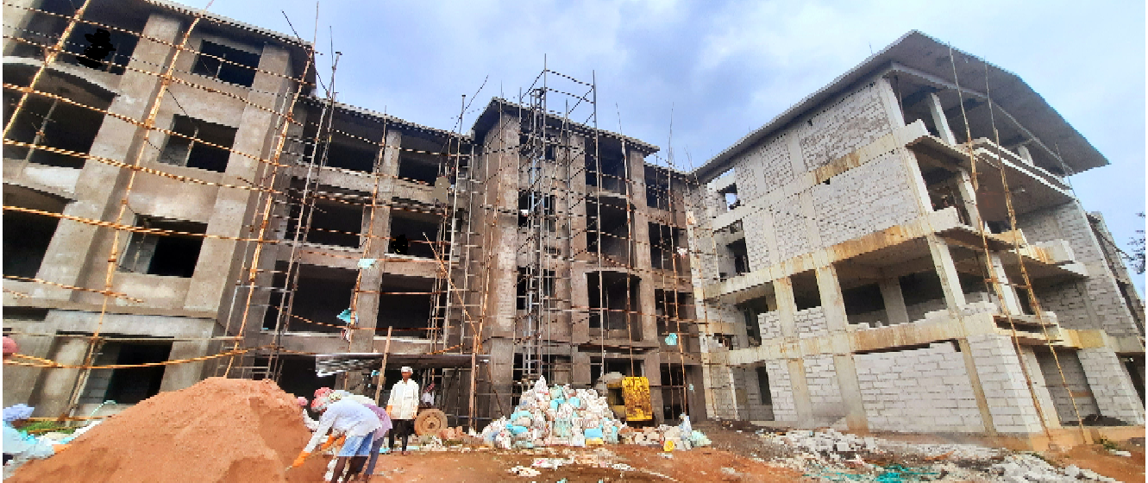
Construction in progress – A3 Building: RCC Structure upto roof slab completed.
Plastering of the façade of the building is in full swing

Slide 7
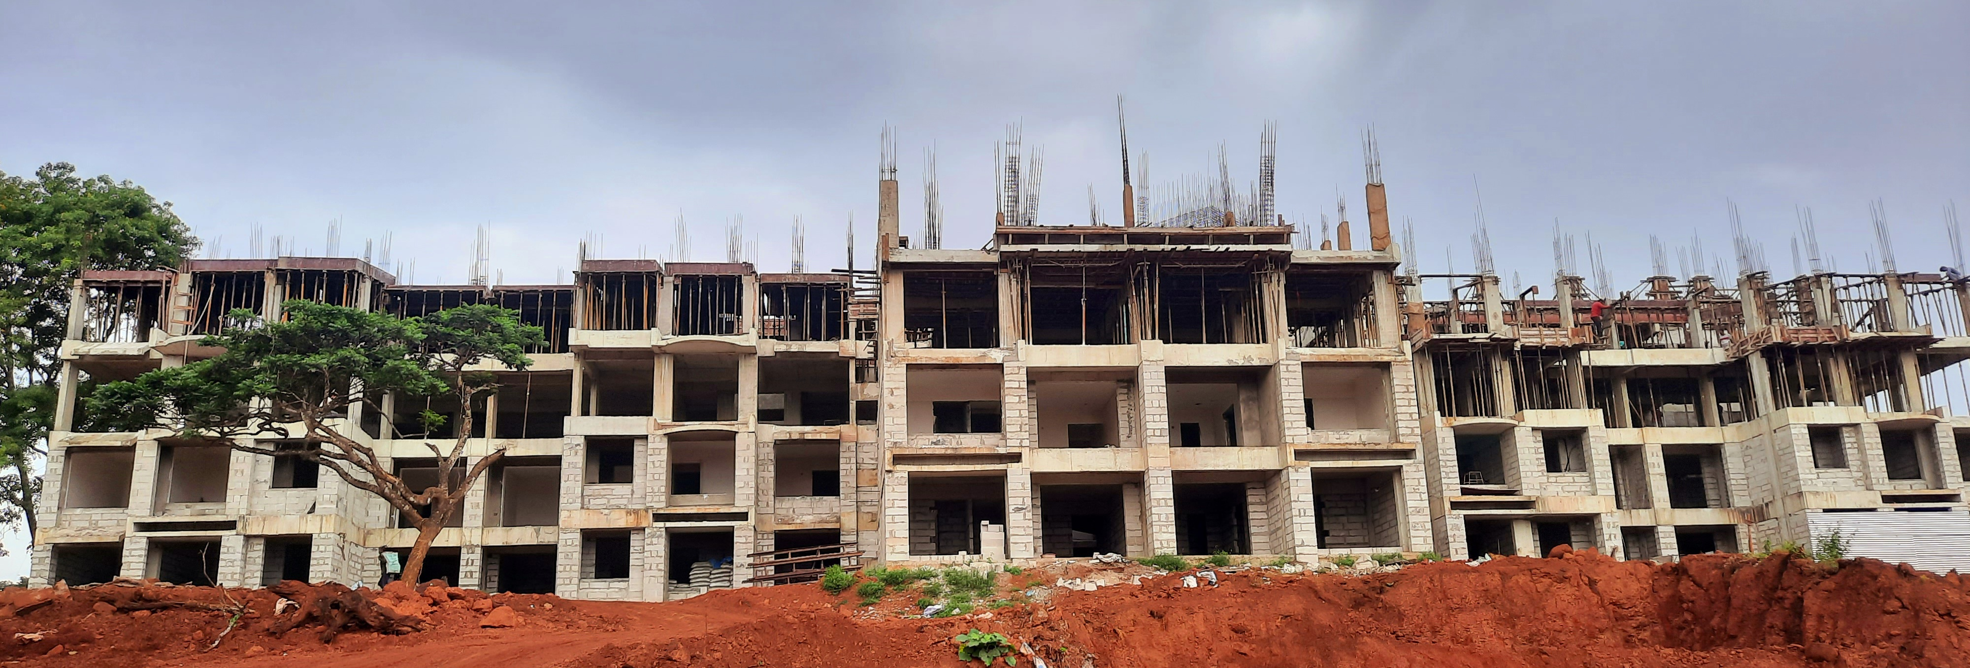
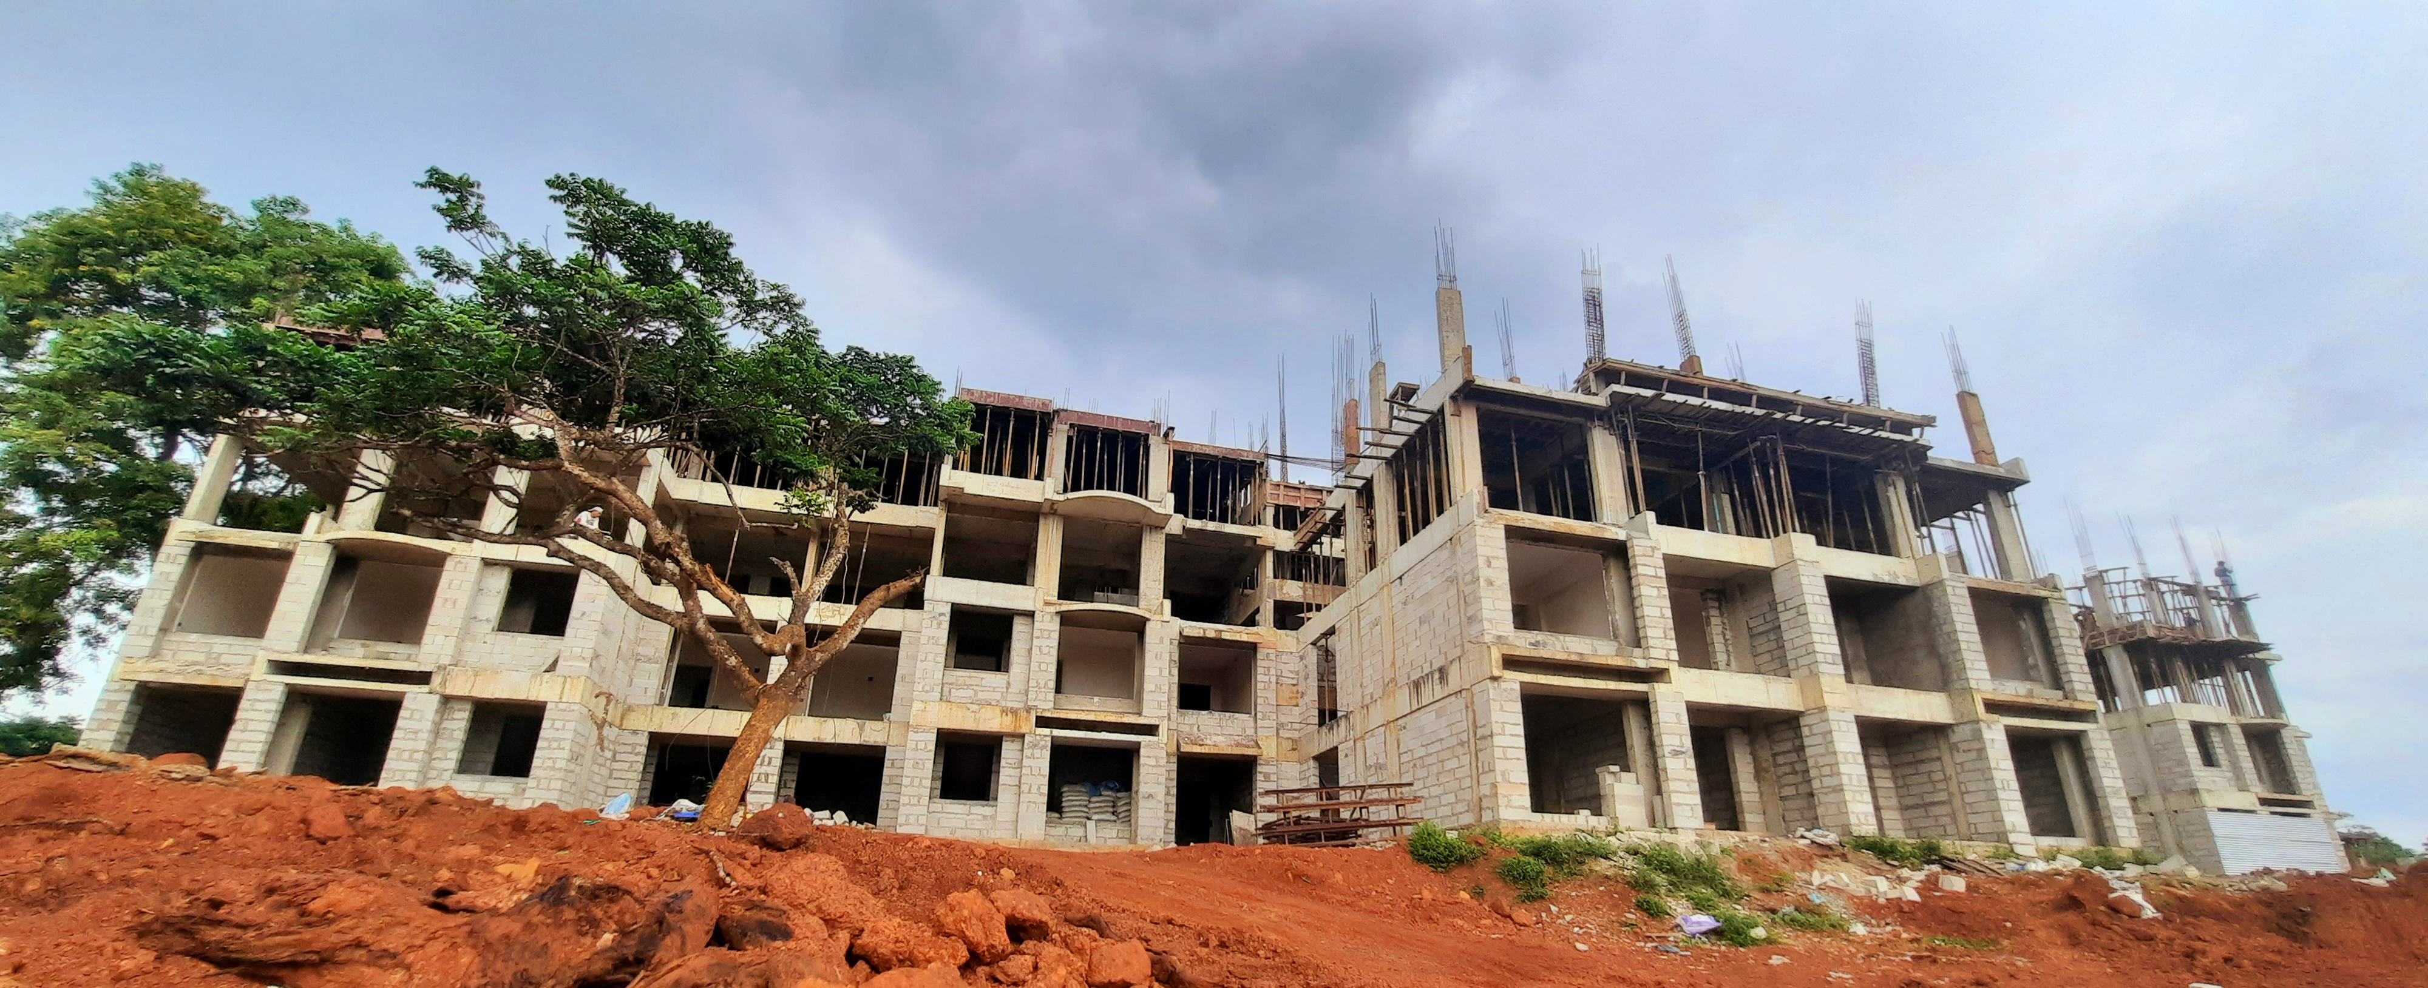
Construction in progress – A4 Building: RCC Structure completed upto 3rd Floor.

Slide 8
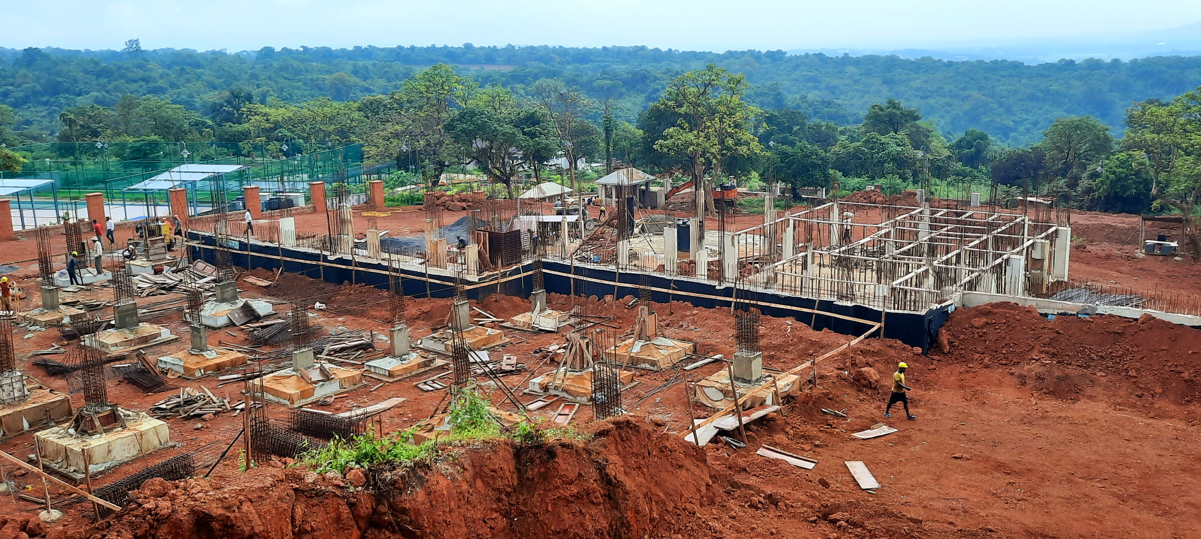
Construction in progress – Club Building retaining wall completed and Lower Ground Level plinth completed.

Slide 9
Thank you
Address: Ikigai Goa Senior living at Prescon Amanha, Survey No. 8/1-D1, Azossim, Tiswadi, North Goa, 403104
This project is registered under GoaRera Project Registration as Bldg A3, Bldg A4 & Club with Reg. No. PRGO02221540

